Slide 1

Basic Object-Oriented Programming in Java
CMPS 251
Read Chapters 3 & 6
Unit 2_01
Notes:
Must see https://github.com/eugenp/tutorials/tree/master/core-java-modules

Slide 2
Outline
Classes and Objects
Attributes with Getters and Setters
Methods
Constructors
Access Modifiers
Variable Types
Enumeration
Notes:
Similarities and differences between Java and C++
Acknowledgment: Some of the slides are based on the slides by Marty Hall available at
http://courses.coreservlets.com/Course-Materials/java.html

Slide 3
Classes and Objects

Slide 4
Class
Object-Oriented Programming (OOP) = Designing the application based on the objects discovered when analyzing the problem
A class is code that describes a particular type of object. It specifies the data that an object can hold (attributes), and the actions that an object can perform (methods).
A class is a programmer-defined data type and objects are variables of that type
A class contains attributes and methods
Notes:
“Class” means a category of things
A class name can be used in Java as the type of an attribute or local variable or as the return type of a function (method)
“Object” means a particular item that belongs to a class
Also called an “instance”
Example
String s1 = "Hello";
Here, String is the class, and the variable s1 and the value "Hello" are objects (or “instances of the String class”)
A class generally contains private attributes (i.e., private variables) and public methods (also called member functions)
Contain data members and member functions (actions to be performed on that data)
and common relationships to other objects
A class is template for objects:
Represents similar objects that have common properties and common methods
Class is template or plan for objects.
Class contains all the common features of the objects.
We can consider Class like Datatype (Int, Char, Float, etc…).
You can declare as many variables of any Datatype in your program for Example :
int day; int count; int divisor; int answer;
In a similar way, you can define many objects of the same class.
Each variable has it’s own value, also each object has it’s own attributes values.
A unit of abstraction in an object oriented (OO) program
A class is an abstraction in that it:
Emphasizes relevant characteristics
Suppresses other characteristics
Abstraction helps us deal with complexity
Its instances
A kind of software module
Describes its instances’ structure (properties)
Contains methods (i.e., functions) to implement their behavior

Slide 5
Class and Objects
A object must be uniquely identifiable and it must have state i.e. my book, student Fatima
A class is a structure of similar objects, a single object is not identified i.e. Book, Student
☺
☹
are instances of
the Student class in UML
Ali
465789
progressed
Fatmah
234564
suspended
Class
STUDENT
😐
☺
variables/
attributes
SID: INT;
Name: CHAR;
Status:CHAR
Noura
453234
progressed
Mohamed
978866
deferred
methods/
operations
prepareExam():BOOL;
enrol(S_ID:INT):BOOL;
Four student objects
Class is a structure of similar objects.

Slide 6
BankAccount Example
An Object has:
Attributes – information about the object
Methods – functions the object can perform
deposit
Private data:
accoutNumber
balance
withdraw
getBalance
getOnwer
setOnwer
BankAccount contains attributes
and methods
Notes:
openAccount , closeAccount (belong to the Bank class).

Slide 7
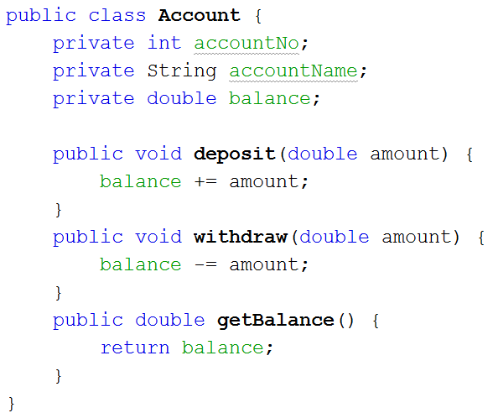
Class Example
private data
Methods
Attributes
withdraw
deposit
accountNo
accountName
balance
getBalance
public methods
…..
Bank Account Object
Notes:
A key feature that give interfaces their power is that you can declare a variable with an interface as its type. This means that an instance of any class that implements the interface can be put in the variable. With the variable, you can then call any of the operations defined in the interface then dynamic binding is used to resolve which concrete method will be called.

Slide 8
Java Naming Conventions
Start classes with uppercase letters
/** Short description of the class */
public class MyClass {
...
}
Start other things with lowercase letters: attributes, local variables, methods, method parameters
public class MyClass {
private String firstName, lastName;
public String getFullName() {
String name = firstName + " " + lastName;
return name;
}
}
Use JavaDoc-style comments

Slide 9
Using a class: Instantiation
To use a class you must create an object from a class (this is called instantiation)
An object is an instance of a class
Instantiation = Object creation with new keyword
e.g., Account myAcc = new Account();
This declares myAcc object of type Account. The object is then created using the new keyword
Memory is allocated for the object’s attributes as defined in the class
Notes:
Car analogy
Pressing a car’s gas pedal sends a message to the car to perform a task—make the car go faster.
The farther down you press the pedal, the faster the car accelerates.
Message to the car includes the task to perform and additional information that helps the car perform the task.
Parameter: Additional information a method needs to perform its task.
Creating objects
Compiler must know size of object
C++ objects typically contain only data members
Compiler creates one copy of class’s member functions
This copy is shared among all the class’s objects
C++ is an extensible language = you can create new data types

Slide 10
Object Oriented Example
Describe a rectangle
What properties does it have? (Attributes)
What operations do we want to perform with it? (Methods)
Objects have two general capabilities:
Store data in attributes
Perform operations using methods

Slide 11
Object Oriented Solution
First, define what a rectangle looks like:
Next, use it to solve the problem:
public class Rectangle {
public int width;
public int height;
public int computeArea() {
return width*height;
}
}
public class App {
public static void main(String[] args) {
Rectangle r = new Rectangle();
r.width = 5;
r.height = 7;
int area = r.computeArea();
System.out.printf("Area is %d\n",area);
}
}

Slide 12
Attributes

Slide 13
Attributes
Attributes = data that is stored inside an object. Also called ‘Instance variables’ or ‘data members’
Syntax
public class MyClass {
private SomeType attribute1;
private SomeType attribute2;
}
Attributes = Local variables in a class definition
Exist throughout the life of the object
It is conventional to make all attributes private for data hiding
Notes:
In any class that also has methods, it is almost always better to declare instance variables private. We will show how and why in the next tutorial section.
Can access attributes of current object without varName
It is conventional to make all instance variables private
In which case outside code can’t access them directly. We will show later how to hook them to outside with methods.

Slide 14
Attributes
Each object of a class maintains its own copy of attributes
e.g., different accounts can have different balances
Access-specifier private used for Data hiding
Makes an attribute or a method accessible only to methods of the class
An attempt to access a private attribute outside a class is a compilation error
Notes:
private is the default access for class members
Also called Attributes or Properties
Variables declared in a function definition’s body
Cannot be used outside of that function body
When a function terminates
The values of its local variables are lost

Slide 15
Accessor methods
Ideas
Attributes should always be private
And made accessible to outside world with get and set methods (also know as Accessor methods)
Syntax
public class MyClass {
private String firstName;
public void setFirstName(String fName)
{ firstName = fName; }
public String getFirstName()
{ return firstName; }
}
Motivation
Allow data validation before assigning values to the object attributes
Limits accidental changes
Notes:
Lets you change internal representation and data structures without affecting the users of your class
Makes code more maintainable.
Lets you put constraints on values to be assigned to attributes (i.e., data validation).
Lets you perform extra behavior (e.g., log old values) in the setters

Slide 16
Accessor methods get Methods and set Methods
Best practice is to provide a get method to read an attribute and a set method to write to an attribute
Data is protected from the client. Get and set methods are used rather than directly accessing the attributes
Using set and get functions allows the programmer to control how clients access private data + allow data validation:
Can return errors indicating that attempts were made to assign invalid data
set and get methods should also be used even inside the class
Notes:
public member functions that allow clients of a class to set or get the values of private data members
set functions are sometimes called mutators and get functions are sometimes called accessors
Returning a value from a function
A function that specifies a return type other than void
Must return a value to its calling function
Always try to localize the effects of changes to a class’s data members by accessing and manipulating the data members through their get and set functions. Changes to the name of a data member or the data type used to store a data member then affect only the corresponding get and set functions, but not the callers of those functions.

Slide 17
UML Diagram and Java Code
public class Rectangle
{
private double width;
private double length;
public void setWidth(double w)
{ width = w;
}
public void setLength(double l)
{ length = l;
}
public double getWidth()
{ return width;
}
public double getLength()
{ return length;
}
public double getArea()
{ return length * width;
}
}
Rectangle
width : double
length : double
CMPS 251 (Object-Oriented Programming), Mohammad Saleh, Spring 2015, CSE-CENG-QU
+ setWidth(w : double) : void
+ setLength(l : double): void
+ getWidth() : double
+ getLength() : double
+ getArea() : double

Slide 18
Generating Getters and Setters
Eclipse will automatically generate getters/setters from instance variables
R-click anywhere in code
Choose Source → Generate Getters and Setters

Slide 19
Methods

Slide 20
Methods
Definition
Functions that are defined inside a class. Also called “member functions”.
Syntax
public ReturnType methodName(Type1 param1, Type2 param2, ...) {
...
return somethingOfReturnType;
}
Motivation
Lets an object calculate values or do computations, usually based on its current state (i.e. attributes)
In OOP, objects have state and behavior. The methods provide the behavior
Use void if the method returns nothing.
If the method is called only by other methods in the same class, make it private.
Notes:
- If you want code that uses your class to access the method, make it public. If your method is called only by other methods in the same class, make it private.
Basic method declaration:
public ReturnType methodName(Type1 arg1, Type2 arg2, ...) {
...
return(somethingOfReturnType);
}
Exception to this format: if you declare the return type as void
This special syntax that means “this method isn’t going to return a value – it is just going to do some side effect like printing on the screen”
In such a case you do not need (in fact, are not permitted), a return statement that includes a value to be returned

Slide 21
Calling Methods
The usual way that you call a method is by doing the following:
objectName.methodName(argumentsToMethod);
For example,
Rectangle r1 = new Rectangle();
r1.setWidth(3.0);
r1.setLength(4.0);
System.out.println(r1.getArea());
Notes:
Accessing methods in other classes
Get an object that refers to instance of other class
Ship s = new Ship();
Call method on that object
s.move();
Accessing instance vars in same class
Call method directly (no variable name and dot in front)
move();
double d = degreesToRadians()
For local methods, you can use a variable name if you want, and Java automatically defines one called “this” for that purpose. See constructors section.
Accessing static methods
Use ClassName.methodName(args)
double d = Math.cos(Math.PI/2);

Slide 22
Method Visibility
public/private distinction
A declaration of private means that “outside” methods cannot call it – only methods within the same class can
Attempting to call a private method outside the class would result in an error at compile time
Only use public for methods that your class will make available to users
Notes:
In next lecture, we will see that you almost always make instance vars private and use methods to access them

Slide 23
Methods Overloading
Idea
Classes can have more than one method with the same name
The methods have to differ from each other by having different number or types of parameters (or both), so that Java can always tell which one you mean
A method's name and number and type of parameters is called the signature
Syntax
public class MyClass {
public double getRandomNum() { …};
public double getRandomNum(double range) { … }
}
Motivation
Lets you have the same name for methods doing similar operations (ease learning and understanding your program)
Notes:
Idea
Allows you to define more than one function or constructor with the same name
Overloaded functions or constructors must differ in the number or types of their parameters (or both), so that Java can always tell which one you mean
Here are two square methods that differ only in the type of the argument; they would both be permitted inside the same class definition
// square(4) is 16
public int square(int x) { return(x*x); }
// square("four") is "four four"
public String square(String s) { return(s + " " + s);
}

Slide 24
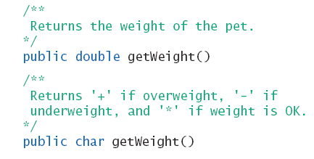
Overloading and Return Type
You must not overload a method where the only difference is the type of value returned

Slide 25
Constructors

Slide 26
Overview
Definition
Constructors = ‘Methods’ used to initialize an object’s attributes when it is created
Constructor is a special initialization method called when an object is created with new.
Syntax
Constructor has the same name as the class and has no return type (not even void).
public class MyClass {
public MyClass(Type paramName, … ) { … }
}
Notes:
Constructor is a special method called when an object is created with new
Constructors are especially useful for supplying values of attributes
Constructors are declared through:
public ClassName(args) {
...
}
Notice that the constructor name must exactly match the class name
Constructors have no return type (not even void), unlike a regular method
Java automatically provides a zero-argument constructor if and only if the class doesn’t define it’s own constructor
That’s why you could say
Ship ship = new Ship();
even though a constructor was never defined
Constructor is a special method called when an object is created with new
Constructors are especially useful for supplying values of attributes
Constructors are declared through:
public ClassName(args) {
...
}
Notice that the constructor name must exactly match the class name
Constructors have no return type (not even void), unlike a regular method
Java automatically provides a zero-argument constructor if and only if the class doesn’t define it’s own constructor
That’s why you could say
Ship ship = new Ship();
even though a constructor was never defined
Lets you run side effects when class is instantiated
Definition
Code that gets executed when “new” is called
Syntax
“Method” that exactly matches the class name and has no return type (not even void).
public class MyClass {
public MyClass(…) { … }
}
Motivation
Lets you build an instance of the class, and assign values to instance variables, all in one fell swoop

Slide 27
Initializing Objects with Constructors
A class can have one or more different constructors
We distinguish between constructors using different number and types of parameters
Default constructor has no parameters and has an empty body
Java will define this automatically if the class does not have any constructors
If you do define a constructor, Java will not automatically define a default constructor
Notes:
Some objects we create will require some sort of initialization
e.g., when we create an instance of a Student class the system should automatically set the studentId to an auto-generated number
A class’s constructor is automatically called by the compiler each time an object of that class is created
A constructor function has the same name as the class and has no return type
Compiler’s default constructor only calls constructors of data members that are objects of classes

Slide 28
Adding constructors to the Rectangle class
public class Rectangle{
private double width;
private double length;
public Rectangle(){
}
public Rectangle(double w, double l){
width = w;
length = l;
}
public void setWidth(double w){
width = w;
}
public void setLength(double l){
length = l;
}
public double getWidth(){
return width;
}
public double getLength(){
return length;
}
public double getArea(){
return length * width;
}
}
CMPS 251 (Object-Oriented Programming), Mohammad Saleh, Spring 2015, CSE-CENG-QU

Slide 29
The this Variable
The this object reference can be used inside any non-static method to refer to the current object
this is used to refer to the object from inside its class definition
The keyword this stands for the receiving object
this is commonly used to resolve name conflicts
Using this permits the use of attributes in methods that have local variables / parameters with the same name
public void setName(String name) {
this.name = name;
}
This is an attribute. To avoid confusion we add this. in-front of it
This is a parameter
Notes:
To pass a reference to the current object as a parameter to other methods
someMethod(this);
- Note that it is only necessary to say this.attributeName when you have a local variable and a class attribute with the same name; otherwise just use attributeName with no this

Slide 30
Constructor Example
Constructor = special method that handles the object initialization
A constructor is used to initialize the objects during object construction.
Example:
Account saraAcct = new Account(123, "Sara", 100.0);
public class Account {
private int id;
private String name;
private double balance;
public Account (int id, String name, double balance) {
this.id = id;
this.name = name;
this.balance = balance;
}
...
}
Constructor

Slide 31
Access Modifiers

Slide 32
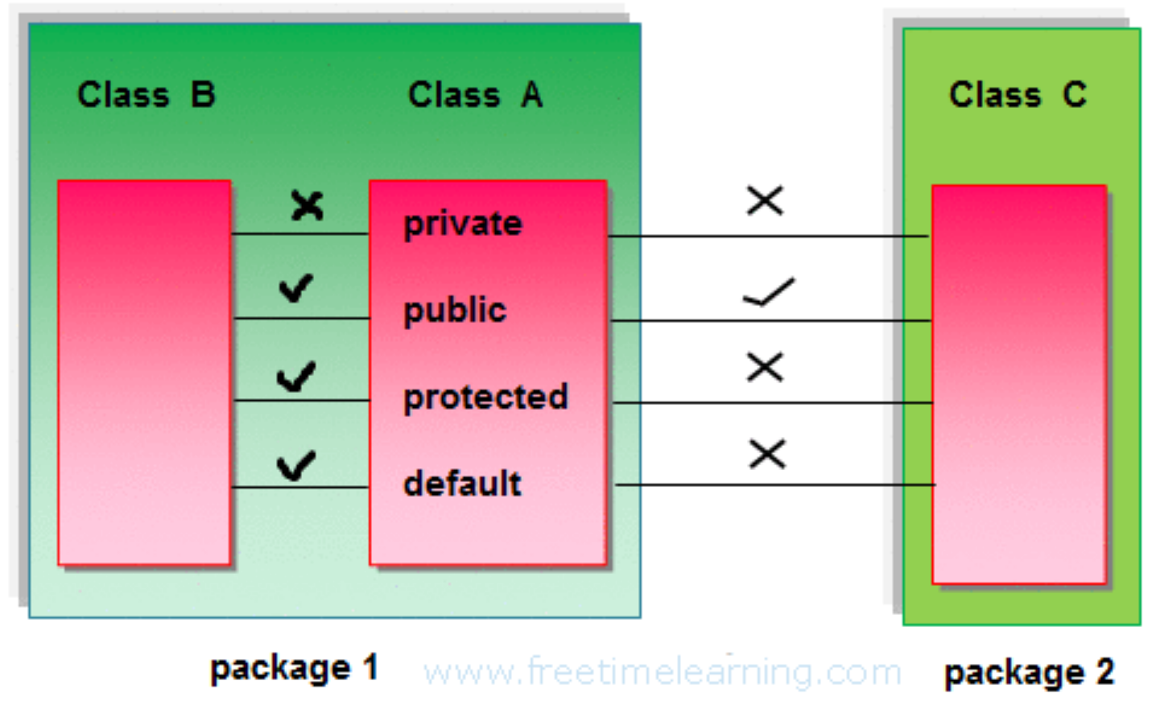
Access Modifiers
Java language has four access modifier to control access to classes, attributes, methods and constructors.
Private: visible only within the class
Default (no modifier): visible only within the same package.
Very rarely used. Don’t omit modifier without a good reason.
Protected: visible within the same package and to sub classes outside the package.
Public: visible everywhere
Notes:
public
This modifier indicates that the attribute or method can be accessed anywhere an instance of the class is accessible
Subclass methods can refer to public and protected members inherited from the superclass simply by using the member names.
private
A private variable or method is only accessible from methods within the same class
private members are hidden even in subclasses
Declare all attributes private
Declare methods private if they are not part of class contract and are just internal implementation helpers
protected – see next slides

Slide 33
Access Modifiers
To use a modifier, you include its keyword (public, private, protected) in the definition of a class, method, or variable.
The modifier precedes the rest of the statement.

Slide 34
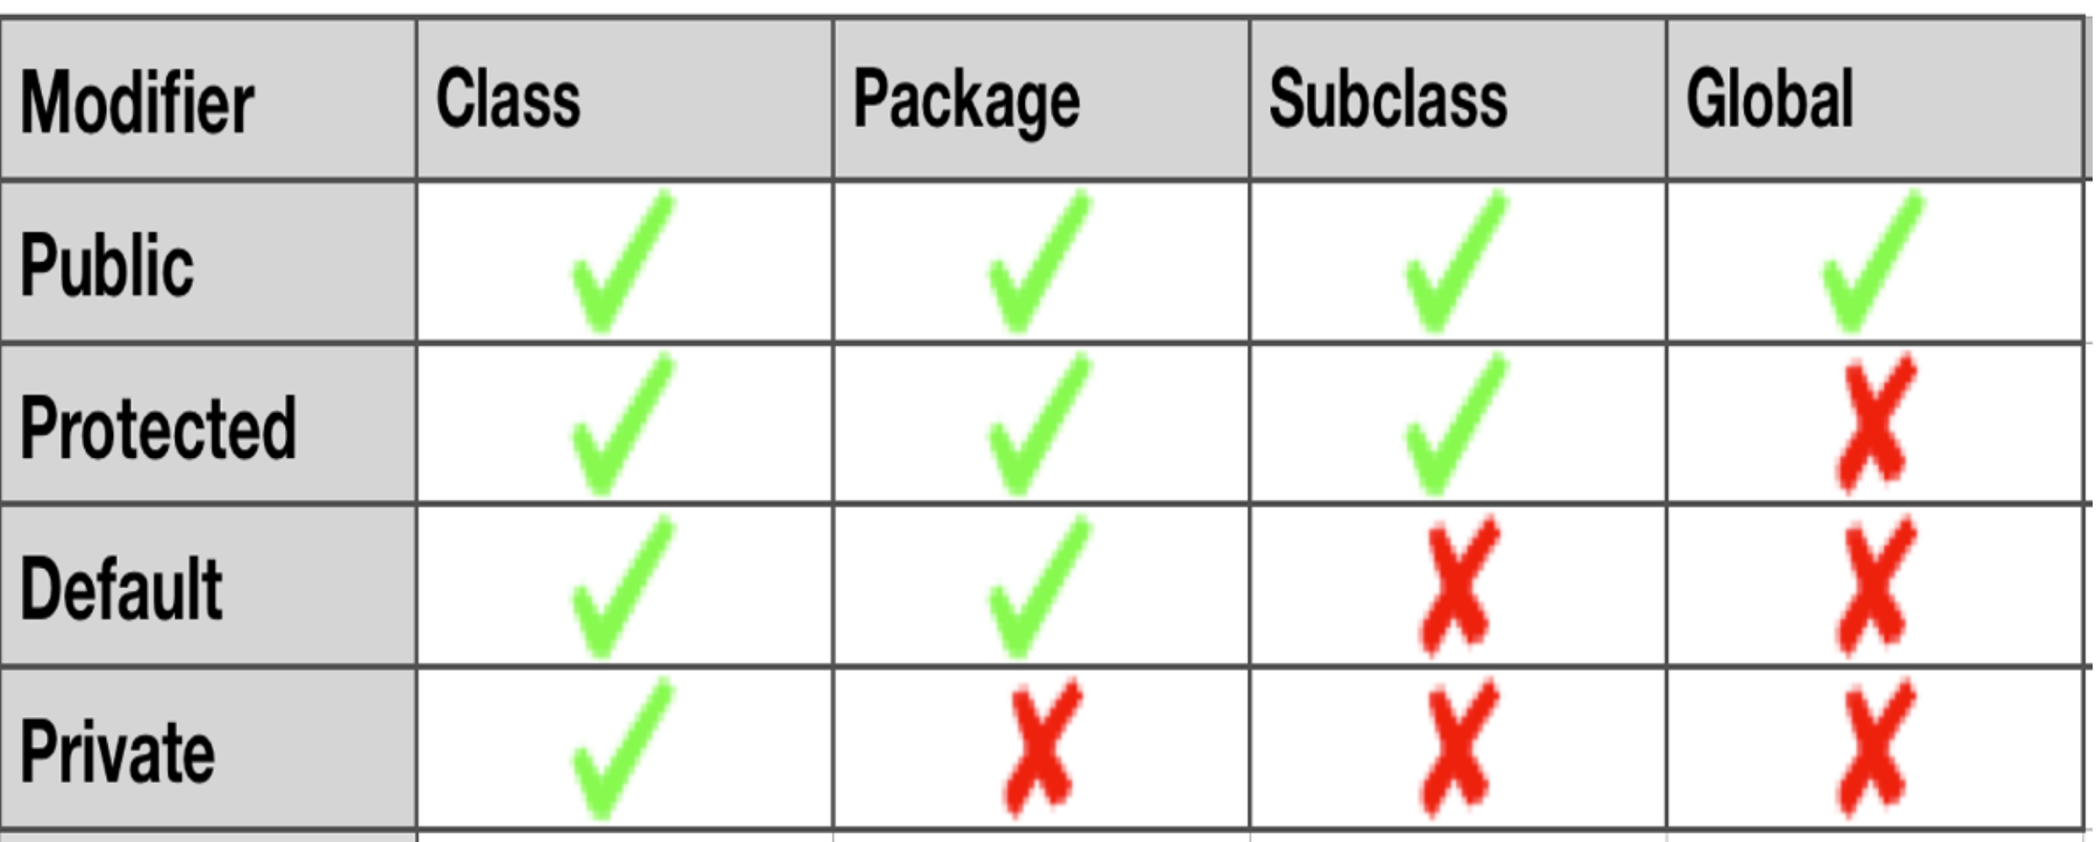
Access Modifiers Summary
Notes:
An attribute or a method has default visibility if the access modifier is omitted. Rarely used!
Default visibility indicates that the attribute or method can be accessed by methods within the class, and within classes in the same package
The default visibility is similar to protected except that default methods can only be inherited by subclasses in the same package.
Common practice:
private: very common. Use this as first choice for attributes.
public: common for methods and constructors.
protected: usually for attributes only. Moderately rare.
default: very rare. Don’t omit modifier without a good reason.

Slide 35
Variables
Local variables: variables defined inside methods, constructors or blocks are called local variables. The variable will be declared and initialized within the method and the variable will be destroyed when the method is completed.
Instance variables: Instance variables are variables defined inside a class but outside any method. These variables are instantiated when objects are created. Instance variables can be accessed from inside any method, constructor or blocks of that particular class.
Static (or, Class) variables: Class variables are variables declared within a class, outside any method, with the static keyword.
Notes:
Start here

Slide 36
Local variables
Local variables are declared in methods, constructors, or blocks.
Access modifiers cannot be used for local variables.
Local variables are visible only within the declared method, constructor or block.
There is no default value for local variables so local variables should be declared and an initial value should be assigned before the first use.
CMPS 251 (Object-Oriented Programming), Mohammad Saleh, Spring 2015, CSE-CENG-QU

Slide 37
Instance variables
Instance variables are declared in a class, but outside a method, constructor or any block.
When a space is allocated for an object in the heap a slot for each instance variable value is created.
Instance variables are created when an object is created with the use of the key word 'new' and destroyed when the object is destroyed.
Access modifiers can be given for instance variables.
The instance variables are visible for all methods, constructors and block in the class. Normally it is recommended to make these variables private (access level).
Instance variables have default values. For numbers the default value is 0, for Booleans it is false and for object references it is null. Values can be assigned during the declaration or within the constructor.
Instance variables can be accessed directly by calling the variable name inside the class.
CMPS 251 (Object-Oriented Programming), Mohammad Saleh, Spring 2015, CSE-CENG-QU

Slide 38
Class/static variables
Class variables also known as static variables are declared with the static keyword in a class, but outside a method, constructor or a block.
There would only be one copy of each class variable per class, regardless of how many objects are created from it.
All objects of that class share that same one copy
Any change in the static variable can be seen by all objects
When declaring class variables as public static final, then variables names (constants) are all in upper case. Constant variables never change from their initial value.
Static variables are created when the program starts and destroyed when the program stops.
Visibility is similar to instance variables. However, most static variables are declared public since they must be available for users of the class.
Default values are same as instance variables.
Static variables can be accessed by calling with the class name . ClassName.VariableName.
CMPS 251 (Object-Oriented Programming), Mohammad Saleh, Spring 2015, CSE-CENG-QU

Slide 39
Static Methods
A static method belongs to the class rather than the object of the class.
Also known as “class methods” (vs. “instance methods”)
A static method can only access the static attributes.
A static method can be called without the need for creating an instance of the class.
You call a static method through the class name
ClassName.functionName(arguments);
For example, the Math class has a static method called cos
You can call Math.cos(3.5) without creating an object of the Math class
E.g., the main method is a static method so the system can call it without first creating an object
Notes:
Exam question:
The following combinations of the instance, class methods and variables are valid:
Instance methods can directly access both instance methods and instance variables
Instance methods can also access static variables and static methods directly
static methods can access all static variables and other static methods
static methods cannot access instance variables and instance methods directly; they need some object reference to do so
A static method belongs to the class rather than the object of a class.
A static method can be invoked without the need for creating an instance of a class.
No need to create an object to access the static methods.
A static method can only access the static data variables.
There are two exceptions to requiring a variable name for a method call
Calling a method defined within the class
Use “methodName(args)” instead of “varName.methodName(args)”
You don’t need the variable name and the dot
For example, a Ship class might define a method called degreeesToRadians, then, within another method in the same class definition, do this:
double angle = degreesToRadians(direction);
No variable name and dot is required in front of degreesToRadians since it is defined in the same class as the method that is calling it
Methods that are declared “static”
Use “ClassName.methodName(args)”
, static methods are the only type of methods that main can call directly (i.e. without building an object and calling the method of that object)
and are almost like global functions in other languages

Slide 40
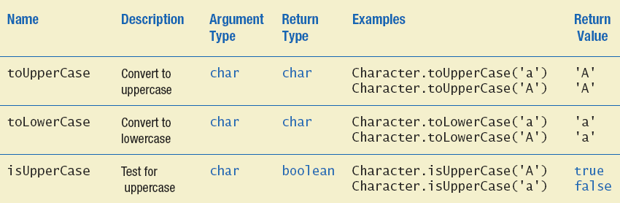
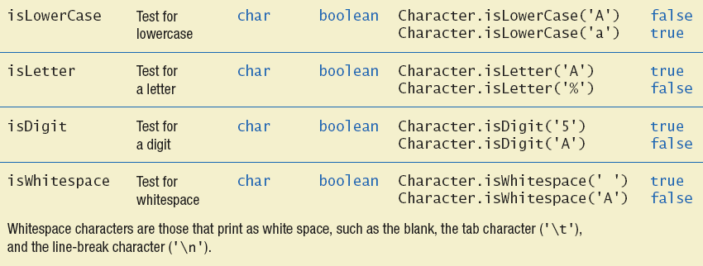
Wrapper Class Example: Static methods in Character class

Slide 41
Enumerations
You can group a set of related constant values in an enum type (short for enumeration).
For example, gender enum values could be Male, Female. The direction could be North, South, East, and West.
It makes sense to create an enum type when the possible values of a variable can be enumerated (e.g., Gender, Direction, Days of week, Month of yea)
An enum type is declared with: enum EnumName
Then a comma-separated list of enum constants
The enum type may optionally include constructors, attributes and methods
Notes:
Like classes, all enum types are reference types
Suppose you have a class with a few instances
Example:
Student Type : <BS, MS, PhD>
SMS Status : <Sent, Delivered, Not Delivered, Not Sent>
Color : <Blue, Green, Black, Red>
How do you implement it?
The class should not be inherited
The instances are limited: no further instances
enum Shape {
Rectangle, Circle, Square
}
enum StudentType{
BS, MS, PhD
}
enum Shape {
Rectangle(1), Circle(2), Square(3);
private int number;
Shape(int i){
number= i;
}
public int getNumber(){
return number;
}
}
Shape shape = Shape.Circle;
print (shape.getNumber());
shape = Shape.valueOf("Rectangle");
print(shape.getNumber());
Shape[] shapesArray = Shape.values();
for (Shape s : shapesArray) {
print(s.name());
}
try{
shape = Shape.valueOf("Pyramid");
}catch(Exception exp){
print("Pyramid is not included in Shape");
}

Slide 42
Enumerations (Cont.)
Each enum internally implemented by using Class with the following restrictions:
enum constants are implicitly final, because they declare constants that shouldn’t be modified.
enum constants are implicitly static.
Any attempt to create an object of an enum type with operator new results in a compilation error.
enum constants can be used anywhere constants can be used.
For every enum, the compiler generates the static method values() that returns an array of the enum’s constants.
When an enum constant is converted to a String, the constant’s identifier is used as the String representation.
Notes:
enum declarations contain two parts—the enum constants and the other members of the enum type.
An enum constructor can specify any number of parameters and can be overloaded.
Every enum internally implemented by using Class./* internally above enum Color is converted to class Color { public static final Color RED = new Color(); public static final Color BLUE = new Color(); public static final Color GREEN = new Color(); }*/

Slide 43
Example 1
public class Main {
enum Level {
LOW,
MEDIUM,
HIGH
}
public static void main(String[] args) {
Level myVar = Level.MEDIUM;
System.out.println(myVar);
}
}
Enum has a values() method, which returns an array of all enum constants. It is useful when you want to use it with loop:
for (Level myVar : Level.values()) {
System.out.println(myVar);
}

Slide 44
Example 2
enum Level {
LOW,
EDIUM,
HIGH
}
public class Main {
public static void main(String[] args) {
Level myVar = Level.MEDIUM;
switch(myVar) {
case LOW:
System.out.println("Low level");
break;
case MEDIUM:
System.out.println("Medium level");
break;
case HIGH:
System.out.println("High level");
break;
}
}
}

Slide 45
enum is actually a class
Color class
enum Color
{
RED,
GREEN,
BLUE;
}
public static objects
/* Internally above enum Color is converted to Color class */
class Color
{
public static final Color RED = new Color();
public static final Color BLUE = new Color();
public static final Color GREEN = new Color();
}
Notes:
https://www.geeksforgeeks.org/enum-in-java/
https://docs.oracle.com/javase/tutorial/java/javaOO/enum.html

Slide 46
TrafficLight Enum Example
You can enhance the enum class with instance attributes and methods
public enum TrafficLight {
// Each object initialize its associated duration.
GREEN(50),
YELLOW(4),
RED(60);
private final int duration;
// Private constructor to set the duration.
private TrafficLight(int duration) {
this.duration = duration;
}
// Public accessor to get the duration.
public int getDuration() {
return duration;
}
}
Notes:
The first pan (lines 7—12) declares six constants. Each is optionally followed by arguments that are passed to the enum constructor (lines 19-22). Like the constructors in classes» an enum constructor can specify any number of parameters and can be overloaded. In this example» the enum constructor requires two String parameters—one that specifies the book's title and one that specifies its copyright year. To properly initialize each enum constant» we follow it with parentheses containing two Stri ng arguments.
The second pan (lines 15-32) declares the enum type’s other members—instance variables title and copyrightYear (lines 15-16), a constructor (lines 19-22) and two methods (lines 25-27 and 30-32) that return the book title and copyright year» respectively.
Each enum constant in enum type Book is an object of enum type Book that has its own copy of instance variables.
Figure 8.11 tests the Book enum and illustrates how to iterate through a range of its constants. For every enum* the compiler generates the static method values (called in line 10), which returns an array of the enum's constants in the order they were declared. Lines 10—13 display the constants. Line 12 invokes the enum Book's getTitle and getCopy- rightYear methods to get the title and copyright year associated with the constant. When an enum constant is converted to a String (e.g., book in line 11), the constant’s identifier is used as the String representation (e.g., JHTP for the first enum constant).

Slide 47
Enum Usage Example
public static void main(String[] args) {
TrafficLight lightState = TrafficLight.GREEN;
// String to Enum value
lightState = TrafficLight.valueOf("GREEN");
System.out.println("lightState value: " + lightState +
" – lightState.toString(): " + lightState.toString());
for (var state : TrafficLight.values()) {
System.out.println(state + " stays on for " +
state.getDuration() + "s");
}
}
lightState value: GREEN - lightState.toString(): GREEN
GREEN stays on for 50s
YELLOW stays on for 4s
RED stays on for 60s
Notes:
print(shape.getNumber());

Slide 48
Programming Conventions and Best Practices
Make all attributes private and provide getters and setters
Class names start with upper case
Method names and variable names start with lower case
Choose meaningful names for classes, methods and variables
makes programs more readable and understandable
Use JavaDoc-style comments to generate useful documentation
Indent nested blocks consistently to communicate the structure of your program
Proper indentation helps comprehension
Notes:
Use accessor methods
Make instance variables private and use getFirstName, setFirstName, getLastName, setLastName
Document code with JavaDoc
Add JavaDoc-style comments so that online API for Person class will be useful
Use inheritance
Make a class (Employee) based on the Person class. Don’t repeat the code from the Person class.
Next lecture
Covers all of these ideas, then shows updated code

